Slide 1
Artificial Intelligence Methods (AE2AIM)
Lec. 02: Linear Programming
Huan Jin

Slide 2
About me
Huan (Joyce) Jin
Email: huan.jin@nottingham.edu.cn
Office: PMB438
Research interests
Artificial Intelligence, OPtimization, Algorithms, Transportation Logistics, Vehicle Routing Problem, Scheduling
Web: https://www.nottingham.edu.cn/en/science-engineering/staffprofile/huan-jin.aspx

Slide 3
Agenda
Matrix
Formulate a Linear Program (LP)
Linear Programing-General Form
LP Algorithm: The Simplex Method
Integer Program (IP)
IP Algorithm: Branch and bound
Classic LP and IP Solvers

Slide 4
Matrices
Matrix notation
Matrix addition and subtraction
Matrix multiplication
Matrix Product
Matrix transposition
Symmetric matrix

Slide 5

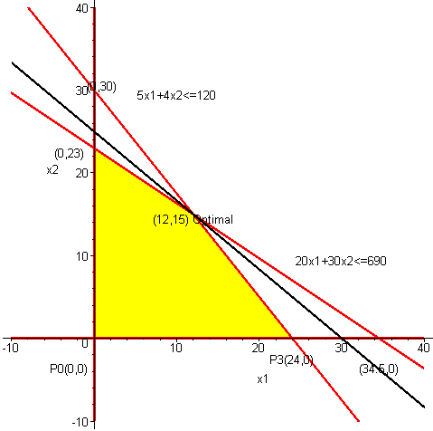
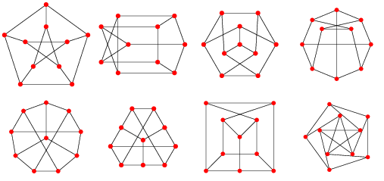
Applications of matrices
Linear Programming
Markov Chains
Graph Theory
Cryptography
Image processing
Machine Learning

Slide 6
Agenda
Matrix
Formulate a Linear Program (LP)
Linear Programing-General Form
LP Algorithm: The Simplex Method
Integer Program (IP)
IP Algorithm: Branch and bound
Classic LP and IP Solvers

Slide 7
A basic example to wake up ☺
A Hot Tub factory produces two types of hot tubs: Aqua-Spas & Hydro-Luxes. Each tub consists of common materials and uses the same labor skills. However, pumps and tubing (common to both) are scarce and expensive. The following data is relevant to the problem of determining the optimal product mix:
The Aqua-Spas use one pump and 12 feet of tubing and require 9 hours of labor. Hydro-Luxes also use one pump but require 16 feet of tubing and 6 hours of labor to build.
Each Aqua-Spa can be sold for a profit of $350 while each Hydro-Lux generates $300. There are 200 pumps, 1566 hours of labor, and 2880 feet of tubing available.
How can we maximize the profit?

Slide 8
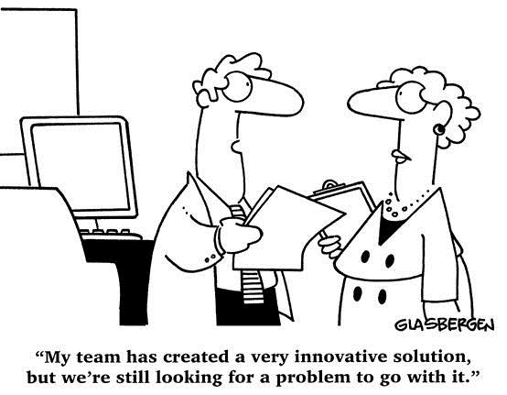
Solution approach (Three basic questions)
What needs to be solved? What is the problem? What are my levers? i.e. What are the Decision Variables?

Slide 9

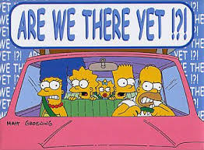
Solution approach (Three basic questions)
What is the criterion? How do we evaluate the solutions? i.e. What is the Objective Function?

Slide 10
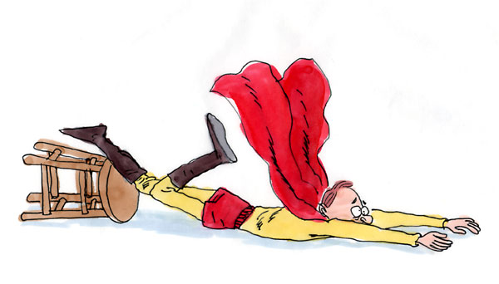
Solution approach (Three basic questions)
What are the limitations? What are my constraints?

Slide 11
Formulate a LP
Step 1: Determine Decision Variables
x₁= The number of Aqua-Spas produced
x₂ = The number of Hydro-Lux produced
Step 2: Formulate Objective Function Max 350x₁ + 300x₂
Step 3: Formulate Constraints
x₁ + x₂ = 200
9x₁ + 6x₂ = 1,566
12x₁ + 16x₂ = 2,880

Slide 12
Formulate a LP
MAX: 350 x₁ + 300 x₂ } profit
s.t.: x₁ + x₂ <= 200 } pumps
9 x₁ + 6 x₂ <= 1566 } labor
12 x₁ + 16 x₂ <= 2880 } tubing
x₁ >= 0 } non-negativity
x₂ >= 0 } non-negativity
Column 1
Column 2

Slide 13
Agenda
Matrix
Formulate a Linear Program (LP)
Linear Programing-General Form
LP Algorithm: The Simplex Method
Integer Program (IP)
IP Algorithm: Branch and bound
Classic LP and IP Solvers

Slide 14
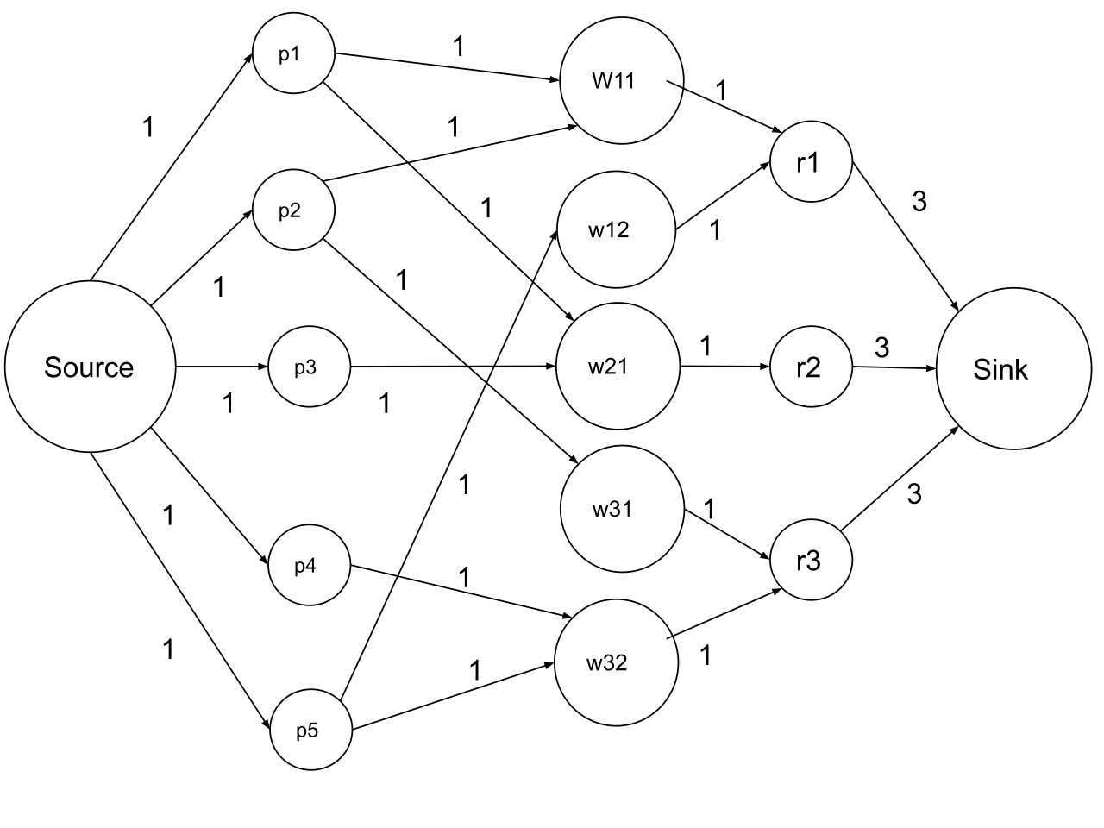

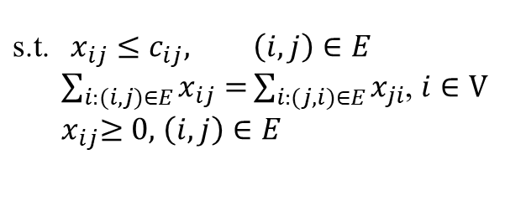

Linear Programming (LP) – example 1
Directed graph G=(V,E)
$c_{ij}$: capacity on edge (i, j)
$x_{ij}$: flow on edge (i, j)
Objective: maximize the flow from source to sink in the network
Maximum flow problem
$$\text{max}\sum_{j:(s,j)∈E}{x_{sj}}$$
$$\text{s}\text{.}\text{t}\text{.} x_{ij}≤c_{ij}, \left(i,j\right)∈E$$
$\sum_{i:(i,j)∈E}{x_{ij}=}\sum_{i:(j,i)∈E}{x_{ji}}$, $i∈V$
${ x}_{ij}≥0,$ $\left(i,j\right)∈E$
source: wiki

Slide 15
Linear Programming (LP) – example 2
Product Mix Problem
A manufacturer has fixed amounts of different resources such as raw material, labor, and equipment.
These resources can be combined to produce any one of several different products.
The quantity of the i^{th} resource required to produce one unit of the j^{th} product is known.
Objective: maximize total income/profit

Slide 16
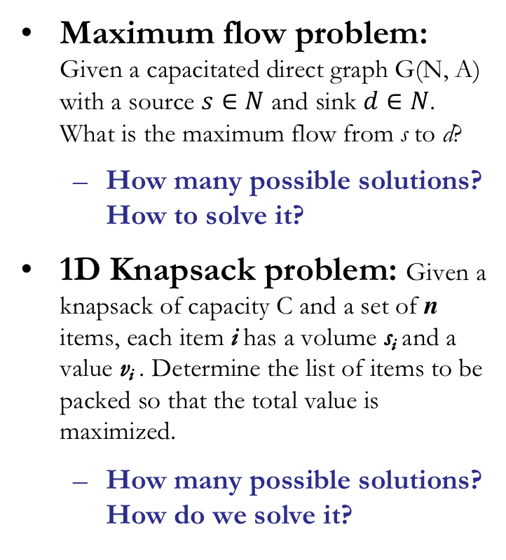
Classic Optimisation Problems
Maximum flow problem: Given a capacitated direct graph G(N, A) with a source $s∈N$ and sink $d∈N$. What is the maximum flow from s to d?
How many possible solutions? How to solve it?
1D Knapsack problem: Given a knapsack of capacity C and a set of n items, each item i has a volume s_{i} and a value v_{i} . Determine the list of items to be packed so that the total value is maximized.
How many possible solutions? How do we solve it?
TSP (Traveling Salesman Problem)
How many possible solution in total? How to find the best solution?
1
D
5
4
2
3
Among the 3 problems, which one is easier to solve, which is harder to solve?

Slide 17
What are these problems in common?

Slide 18

A standard LP formulation
Standard format
Matrix format
max
max $c^{′}x$
subject to $Ax≤b$
$x≥0$
_____________
min $c^{′}x$
subject to $Ax≥b$
$x≥0$
This type of problem can be solved fairy efficiently thanks to a famous algorithm, Simplex method, by George B. Dantzig.

Slide 19
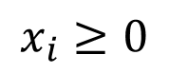
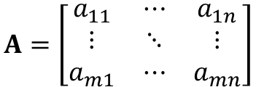
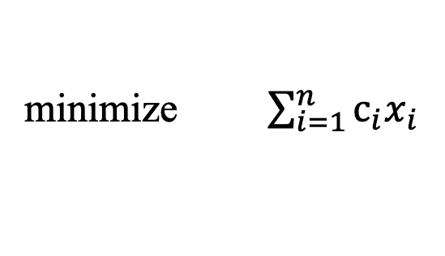
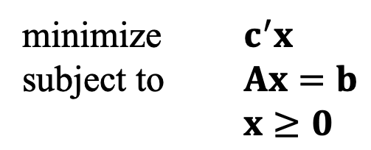
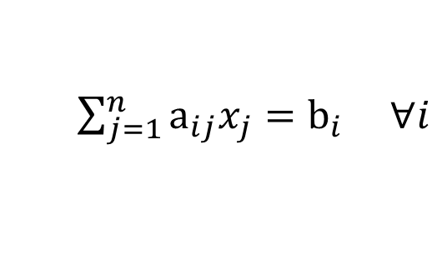
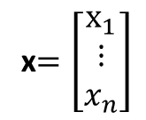
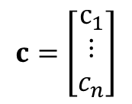
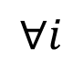
LP– General Formulation
$$c=\left[\begin{matrix}c_{1} \\ ⋮ \\ c_{n}\end{matrix}\right]$$
x$=\left[\begin{matrix}x_{1} \\ ⋮ \\ x_{n}\end{matrix}\right]$
minimize $c^{′}x$
subject to $Ax=b$
$x≥0$
$$A=\left[\begin{matrix}a_{11} & ⋯ & a_{1n} \\ ⋮ & ⋱ & ⋮ \\ a_{m1} & ⋯ & a_{mn}\end{matrix}\right]$$
minimize $\sum_{i=1}^{n}{c_{i}x_{i}}$
Objective Function
subject to
$\sum_{j=1}^{n}{a_{ij}x_{j}}=b_{i}$ $∀i$
Regular Constraints
$$x_{i}≥0$$
$$∀i$$
Non-negativity Constraints

Slide 20
Agenda
Matrix
Formulate a Linear Program (LP)
Linear Programing-General Form
LP Algorithm: The Simplex Method
Integer Program (IP)
IP Algorithm: Branch and bound
Classic LP and IP Solvers

Slide 21
Formulate a LP
Objective
Function
Max 350 x₁ + 300 x₂
s.t.: x₁ + x₂ <= 200
9 x₁ + 6 x₂ <= 1566
12 x₁ + 16 x₂ <= 2880
x₁ >= 0
x₂ >= 0
“Regular”
Constraints
Non-negativity
Constraints

Slide 22
Solving LP Problems: A Graphical Approach
x₂
The constraints of an LP problem defines its feasible region
250
boundary line of pump constraint
x₁ + x₂ = 200
200
boundary line of labor constraint
9x₁ + 6x₂ = 1,566
150
boundary line of tubing constraint
12x₁ + 16x₂ = 2,880
100
Feasible Region
50
0
0
50
100
150
200
250
x₁

Slide 23
Solving LP Problems: A Graphical Approach
x₂
The best point in the feasible region is the optimal solution to the problem
250
objective function
200
350x₁ + 300x₂ = 35,000
150
optimal solution
350x₁ + 300x₂ =66,100
100
objective function
350x₁ + 300x₂ = 52,500
50
0
0
50
100
150
200
250
x₁

Slide 24
Enumerating the Corner Points
x₂
250
Note: This technique will not work if the solution is unbounded.
obj. value = $54,000
200
(0, 180)
obj. value = $64,000
150
(80, 120)
obj. value = $66,100
100
(122, 78)
50
obj. value = $0
obj. value = $60,900
(0, 0)
(174, 0)
0
0
50
100
150
200
250
x₁
Notes:
1. Plot the boundary line of each constraint
2. Identify the feasible region
3. Locate the optimal solution by either:
a. Plotting level curves (i.e., objective function isoquants)
b. Enumerating the extreme points

Slide 25
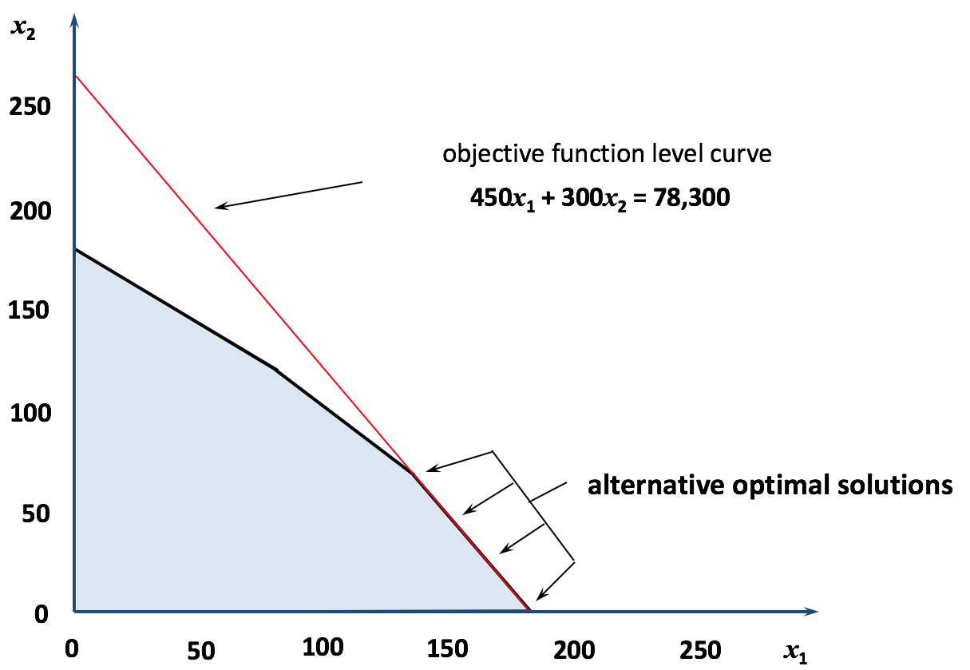
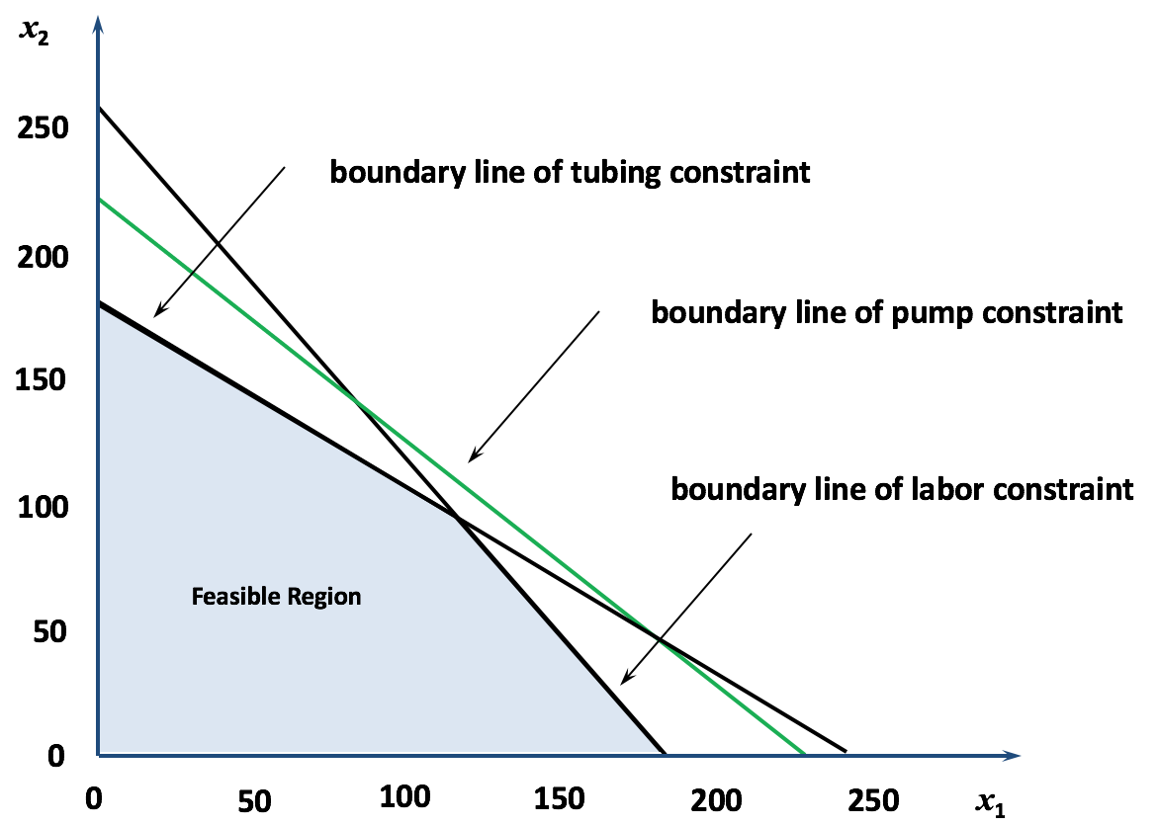
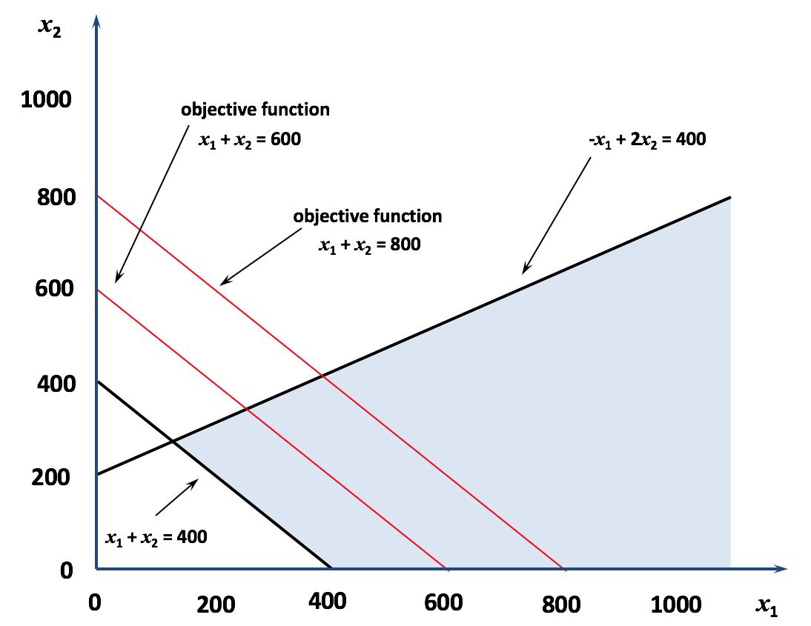
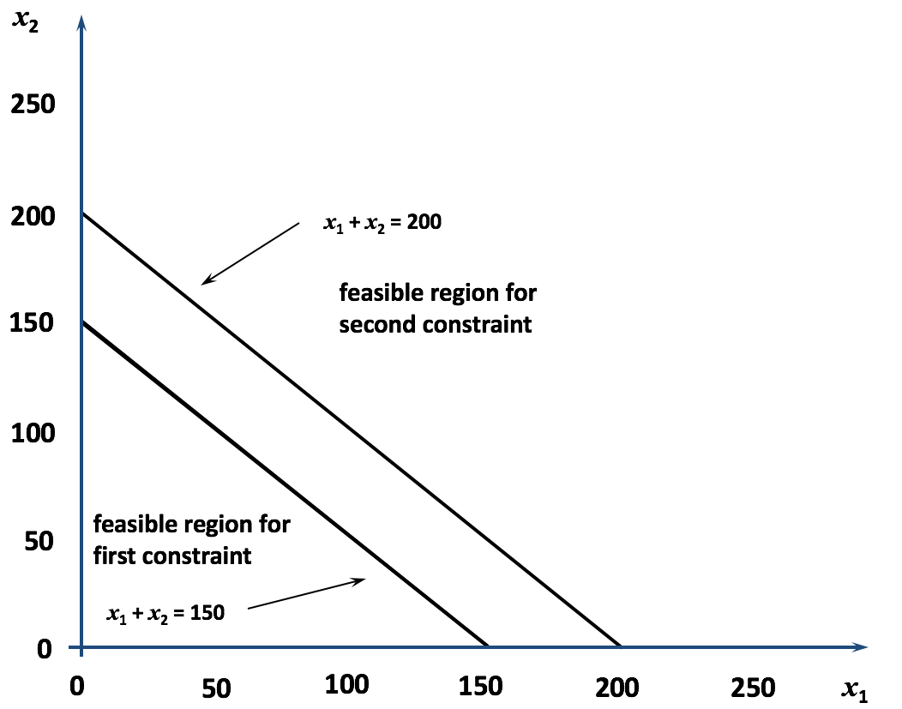
Special Conditions in LP Models
A number of anomalies can occur in LP problems:
Alternative Optimal Solutions
Redundant Constraints
Unbounded Solutions
Infeasibility

Slide 26
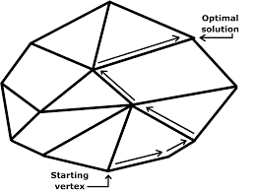
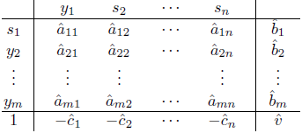
Algorithmic Approaches
Simplex method
It focuses on CPF solutions. In the worst case, it requires a number of steps that is exponential in the size of the problem.
However, it performs well in practice, visiting only a small fraction of the total number of vertices.

Slide 27
The essence of the Simplex method
x₂
CPF Solution | Its adjacent CPF Solutions
(0, 0) | (0, 180) and (174, 0)
(0, 180) | (0, 0) and (80, 120)
(80, 120) | (0, 180) and (122, 78)
(122, 78) | (80, 120) and (174, 0)
(174, 0) | (0, 0) and (122, 78)
250
200
(0, 180)
150
(80, 120)
Optimality test: If a CPF solution has no adjacent CPF solutions that are better (as measured by Z), then it must be an optimal solution.
100
(122, 78)
50
(0, 0)
(174, 0)
0
0
50
100
150
200
250
x₁
Corner-point feasible solutions (CPF solutions)
Notes:
For any linear programming problem with n decision variables, two CPF solutions are adjacent to each other if they share n – 1 constraint boundaries. The two adjacent CPF solutions are connected by a line segment referred to as an edge of the feasible region.

Slide 28
The essence of the Simplex method
x₂
Initialization: Choose (0, 0) as the initial CPF solu-tion to examine.
Optimality test: Conclude that (0, 0) is not an opti-mal solution (adjacent CPF solutions are better)
250
200
Iteration 1: Move to adjacent CPF solution, (174, 0)
Optimality test: Conclude that (174, 0) is not an optimal solution
(0, 180)
z = $54,000
150
(80, 120)
Iteration 2: Move to adjacent CPF solution, (122, 78)
Optimality test: Conclude that (122, 78) is an optimal solution, so stop
z = $64,000
100
(122, 78)
2
z = $66,100
50
0
(0, 0)
(174, 0)
z = $0
1
z = $60,900
0
0
50
100
150
200
250
x₁

Slide 29
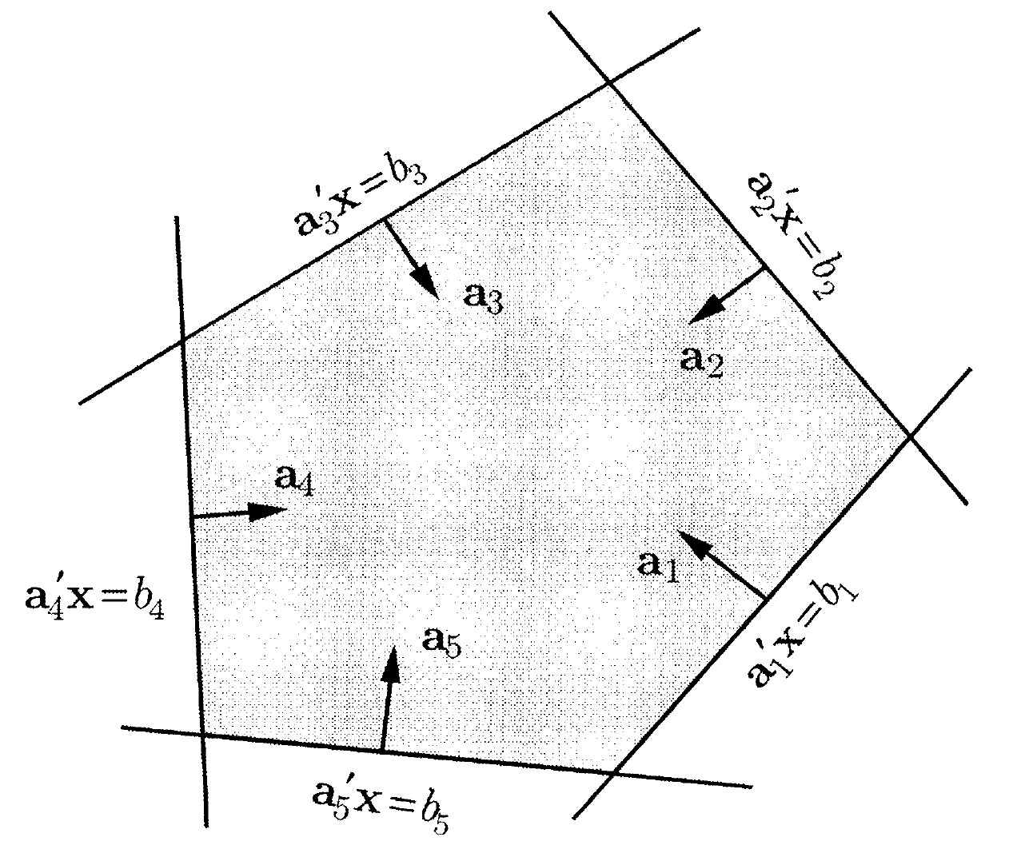
The Convex Hull
The convex hull is the smallest convex set that contains X
Source: Bertsimas, D., & Tsitsiklis, J. N. (1997). Introduction to linear optimization. Belmont, MA: Athena Scientific.

Slide 30
Agenda
Matrix
Formulate a Linear Program (LP)
Linear Programing-General Form
LP Algorithm: The Simplex Method
Integer Program (IP)
IP Algorithm: Branch and bound
Classic LP and IP Solvers

Slide 31
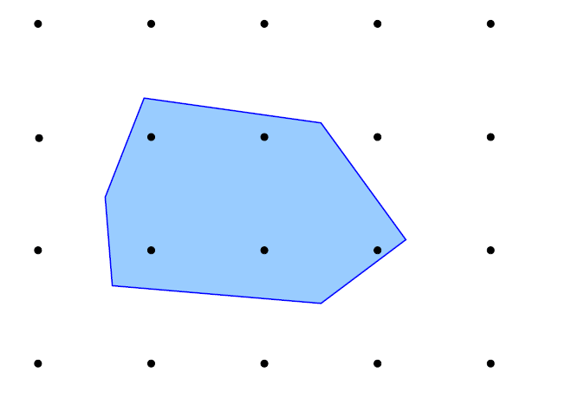
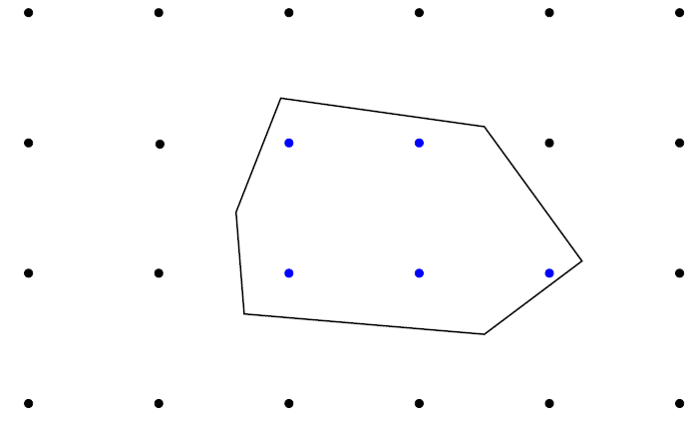
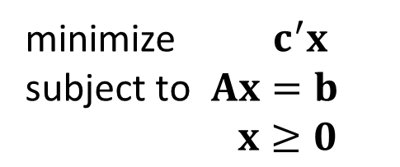
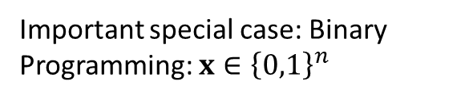
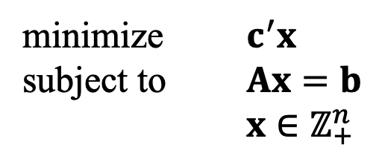
LP and IP
minimize $c^{′}x$
subject to $Ax=b$
$x≥0$
minimize $c^{′}x$
subject to $Ax=b$
$x∈ℤ_{+}^{n}$
Important special case: Binary Programming: $x∈{\left\{0,1\right\}}^{n}$

Slide 32
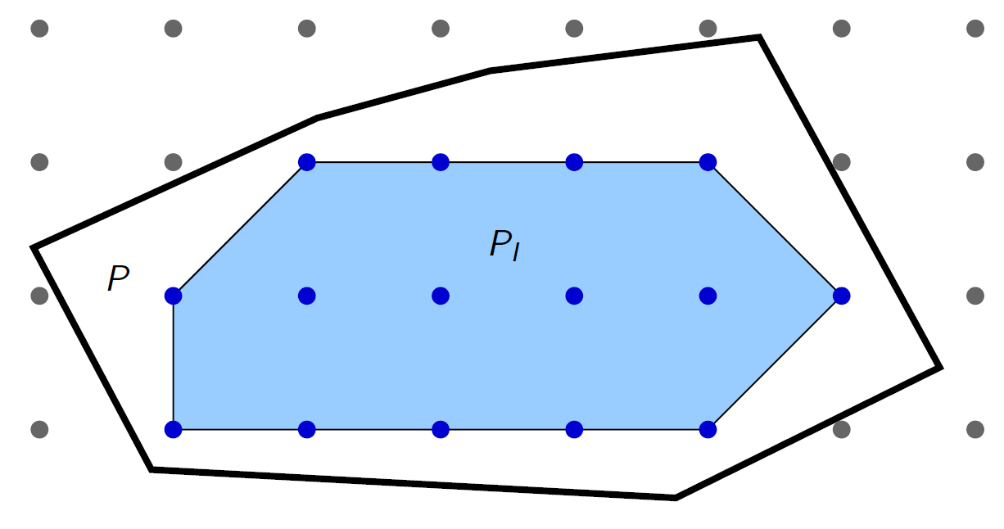
Integer Hull Vs Convex Hull
Integer optimization over P ⇔ linear optimization over PI

Slide 33
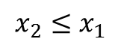
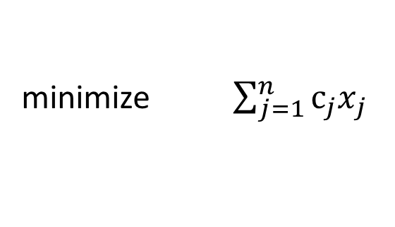
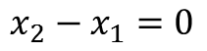
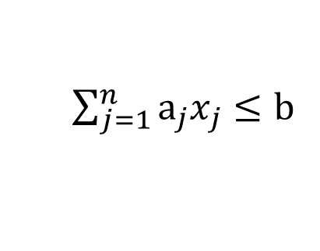
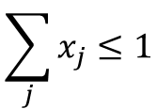
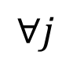
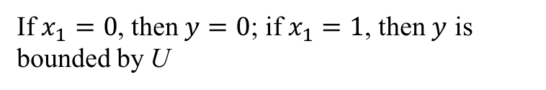

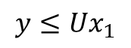
Modeling with binary variables
minimize $\sum_{j=1}^{n}{c_{j}x_{j}}$
Objective Function
subject to
$\sum_{j=1}^{n}{a_{j}x_{j}}≤b$
Constraints
$$x_{j}∈\left\{0,1\right\}$$
$$∀j$$
Binary variables
Potential relations:
$$\sum_{j}{x_{j}}≤1$$
At most one event occurs
$$x_{2}−x_{1}=0$$
Neither or both events occur
$$x_{2}≤x_{1}$$
If one event occurs then, another occurs
$$y≤{Ux}_{1}$$
If $x_{1}=0$, then $y=0$; if $x_{1}=1$, then $y$ is bounded by U

Slide 34
Agenda
Matrix
Formulate a Linear Program (LP)
Linear Programing-General Form
LP Algorithm: The Simplex Method
Integer Program (IP)
IP Algorithm: Branch and bound
Classic LP and IP Solvers

Slide 35
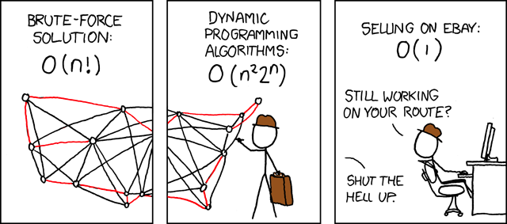
Solution Methods
Brute force

Slide 36
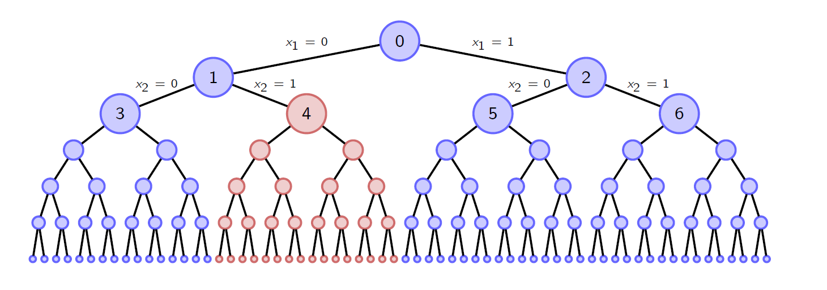
Solution Methods
Branch-and-Bound
Idea: enumerate all possible solutions systematically using a tree (branch). Stop branching from a node as soon as possible (e.g. suppose we look at node 4 and conclude none of its descendants can be optimal), thus we can eliminate 1/4 the solutions at once!

Slide 37
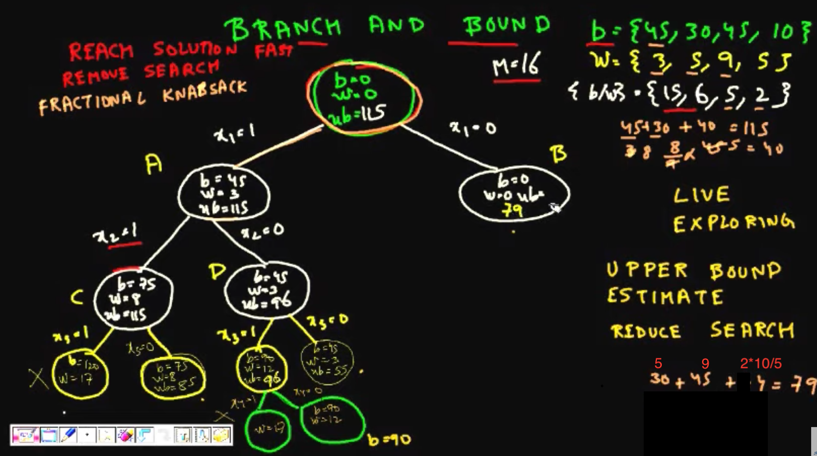
Branch and Bound
Source: https://www.youtube.com/watch?v=R6BQ3gBrfjQ

Slide 38
Agenda
Matrix
Formulate a Linear Program (LP)
Linear Programing-General Form
LP Algorithm: The Simplex Method
Integer Program (IP)
IP Algorithm: Branch and bound
Classic LP and IP Solvers

Slide 39
LP Solvers
LP problems involving 1000s of variables and 1000s of constraints are now routinely solved with computer packages.
Linear programming solvers are now part of many spreadsheet packages, such as Microsoft Excel.
For the previous example, we can easily solve it using Excel solver.
Leading commercial packages include CPLEX,GUROBI, LINGO, MOSEK, Xpress-MP, and Premium Solver for Excel.

Slide 40
Further Reference
Reference
Introduction to operations research / Frederick S. Hillier, Gerald J. Lieberman. McGraw-Hill 2015 Available at Main Library Room
Getting familiar with an LP solver
IBM Cplex, free for academics and students
Supports C/C++, .Net, Java, R, Python etc…
https://ibm.onthehub.com/WebStore/ProductSearchOfferingList.aspx?srch=ilog+cplex
https://www.ibm.com/products/ilog-cplex-optimization-studio
Using IBM Cplex to solve the relaxed knapsack problem
You can either use the OPL or
Call LP solver from a C/C++ program

Slide 41
Supplement: P, NP, NPC, NP-hard

Slide 42
Classic Optimization Problems
Maximum flow problem: Given a capacitated direct graph G(N, A) with a source $s∈N$ and sink $d∈N$. What is the maximum flow from s to d?
How many possible solutions? How to solve it?
1D Knapsack problem: Given a knapsack of capacity C and a set of n items, each item i has a volume s_{i} and a value v_{i} . Determine the list of items to be packed so that the total value is maximized.
How many possible solutions? How do we solve it?
TSP (Traveling Salesman Problem)
How many possible solution in total? How to find the best solution?
1
D
5
4
2
3
Among the 3 problems, which one is easier to solve, which is harder to solve?

Slide 43
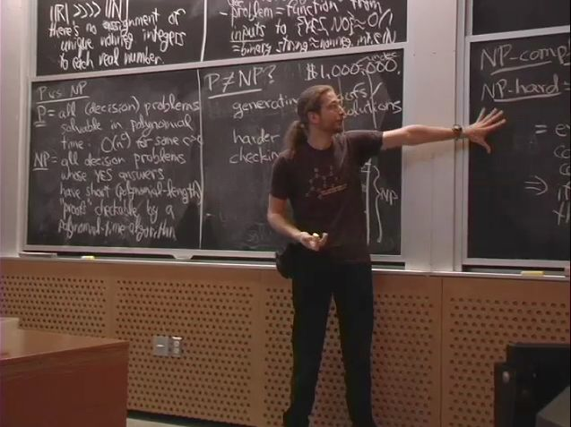
Supplement: P = NP?
NP Problems
P
NP-Complete

